Slide 1
Joseph Akash C 962821205026 B.Tech-IT 3rd Year UCEN
Final Project
3/21/2024 Annual Review

Slide 2
PROJECT TITLE
HAND GESTURE DETECTION USING CNN
3/21/2024 Annual Review

Slide 3


AGENDA
Problem Statement
Project Overview
End Users
Solution
Value Proposition
Wow in the Solution
Modelling
Result
3/21/2024 Annual Review

Slide 4

PROBLEM STATEMENT
Many human-computer interaction scenarios, particularly those involving physical disabilities or hands-free environments, there is a need for accurate and real-time recognition of hand gestures to enable intuitive control of devices and applications. Existing input methods may be cumbersome or inaccessible for certain users, highlighting the necessity for a robust hand gesture recognition system that can reliably interpret and translate hand movements into actionable commands.
3/21/2024 Annual Review

Slide 5

PROJECT OVERVIEW
The hand gesture recognition system is designed to facilitate intuitive human-computer interaction by allowing users to control devices and applications through hand gestures captured via a webcam feed in real-time. Leveraging computer vision techniques and machine learning models, the system interprets and translates detected hand gestures into actionable commands, enabling users to perform various tasks without the need for traditional input devices.
3/21/2024 Annual Review

Slide 6

WHO ARE THE END USERS?
Individuals with Disabilities: Hand gesture recognition provides accessible interaction for users with physical limitations.
Professionals in Specialized Environments: Enables hands-free operation in environments like operating rooms or industrial settings.
Presenters and Speakers: Enhances engagement by allowing gesture-based control of presentations.
Gaming and Entertainment Enthusiasts: Offers immersive gaming experiences through gesture control.
General Users Seeking Intuitive Interaction: Provides a natural and hands-free interaction method for everyday users
3/21/2024 Annual Review

Slide 7

SOLUTION
The solution employs computer vision techniques and deep learning models to analyze facial expressions captured via webcam in real-time. It begins by detecting faces within each frame and then analyzes key facial features like eyes, eyebrows, nose, and mouth. Deep learning models, particularly CNNs, classify these features into emotion categories such as happiness, sadness, anger, and surprise. This real-time processing allows the system to identify the dominant emotion for each individual. The integration of computer vision and deep learning enables accurate insights into emotional states, benefiting applications like human-computer interaction and user experience personalization.
3/21/2024 Annual Review

Slide 8
VALUE PROPOSITION
Accessibility: The system enables individuals with disabilities or limited mobility to interact with technology, fostering inclusivity and empowerment.
Efficiency: Gesture-based interaction streamlines workflow and improves efficiency, particularly in hands-free or specialized environments where traditional input methods may be cumbersome or impractical.
User Experience: By offering a more natural and intuitive mode of interaction, the system enhances user satisfaction and engagement, leading to a more enjoyable and immersive experience.
Innovation: Hand gesture recognition represents a cutting-edge technology that demonstrates innovation and forward-thinking in human-computer interaction, positioning organizations as leaders in their respective fields.
Versatility: The system's versatility allows it to be adapted for various applications and industries, including gaming, healthcare, education, and entertainment, catering to diverse user needs and preferences
3/21/2024 Annual Review
8

Slide 9

THE WOW IN YOUR SOLUTION
The Integration of cutting-edge technology to revolutionize human-computer interaction by enabling users to effortlessly control devices and applications through natural hand gestures, the system eliminates the need for traditional input methods, offering a truly intuitive experience. What sets our solution apart is its accessibility, empowering individuals with disabilities to interact with technology in unprecedented ways.
3/21/2024 Annual Review
9

Slide 10
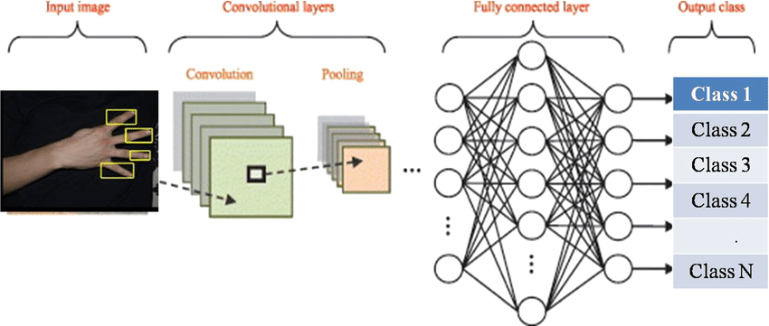
MODELLING
Project Architecture
3/21/2024 Annual Review
10

Slide 11
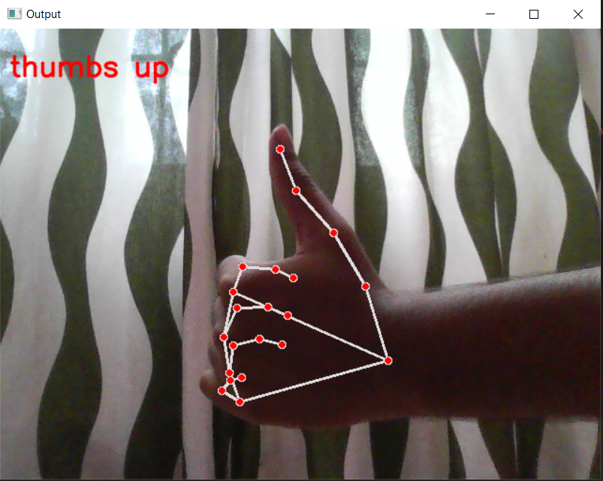
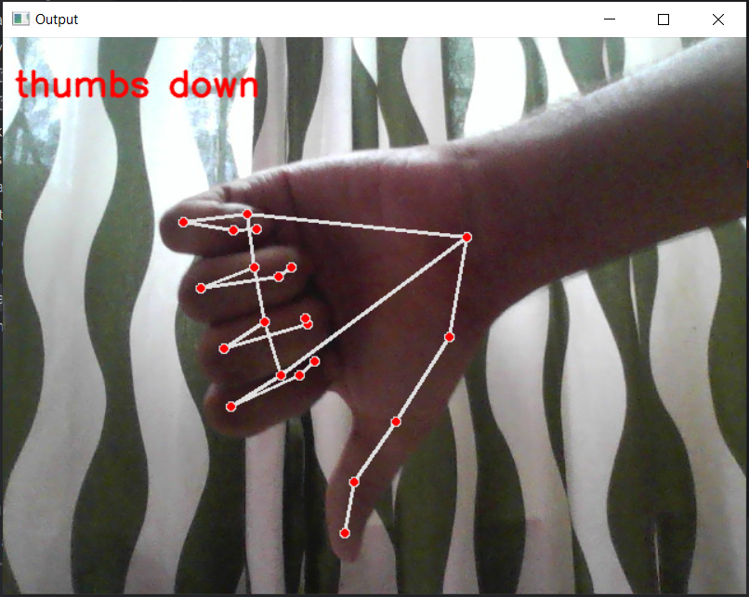
RESULTS
3/21/2024 Annual Review
11

